Slide 1
Airline Reservation System
BY
Dinakaran R P

Slide 2

Agenda
1. Project Overview
2. Workflow
3. Concepts Implemented

Slide 3
Project Overview
Airline Reservation System is a Console-based application.
Customers can buy and cancel tickets based on their needs.
Customers can make payments using the e-transaction process.
Payment can be done through UPI transactions.

Slide 4
Concepts Implemented
Inheritance
Multi threading
Collections

Slide 5
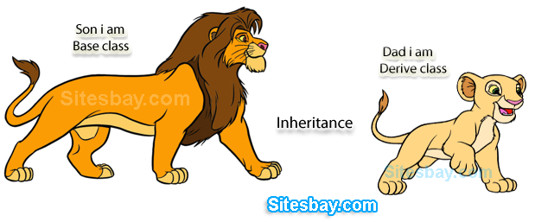
Inheritance
Inheritance in Java is a mechanism in which one object acquires all the properties and behaviours of a parent object.

Slide 6
Multi Threading
Multithreading in Java is a process of executing multiple threads simultaneously.

Slide 7
Collection
Collection is a framework that is used for storing and manipulating data.

Slide 8
Work flow
Start
Signup
Login
Valid user
No
Yes
Reservation

Slide 9
E-payment
Boarding pass
Cancellation
Logout
End

Slide 10
THANK YOU

